Slide 1
FACE MASK DETECTION

Slide 2
INTRODUCTION
By traditional video surveillance methods, a security person will have a duty of staring at hundreds of screens.
It is a challenging job for a person to monitor everything effectively
even between only two screens.
Due to limitations of human eyes, eyes get tired quickly after few minutes even if one has to stare single screen for longer duration.

Slide 3
MOTIVATION
Whereas the action recognition community has focused mostly on detecting simple actions like clapping, walking or jogging, the detection of person wearing mask has been comparatively less studied.
Such capability may be extremely useful in some video surveillance scenarios like in malls, banks, shops where there are very high chances of robbery and other possible threats etc.

Slide 4
OBJECTIVES
Facial part detection is robust and time consuming step.
In certain cases, facial part detection might not detect face when person is wearing mask and hence this is the limitation of facial part detection step.
While lot of research is going on in the field of computer vision and learning, for detection of various events, these proposed steps will definitely give insight to some of the possible ways to find out if person is wearing mask or not.
To further improve the accuracy of these steps, combination of various features can be implemented and performance can be improved.

Slide 5
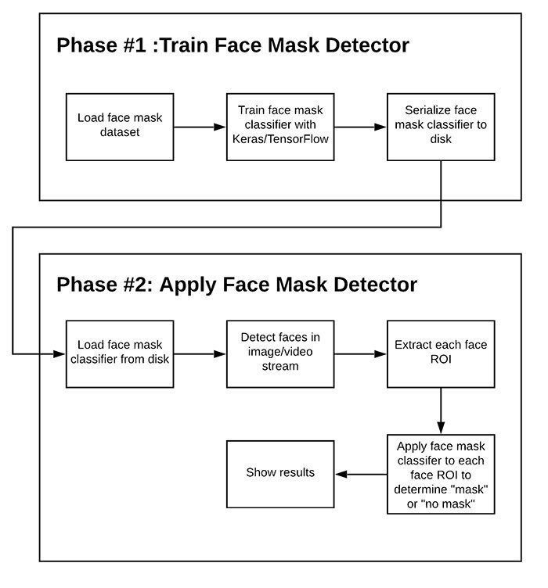
METHODOLOGY AND RESEARCH OUTCOMES OF THE PROJECT

Slide 6
PLAN OF ACTION FOR FURTHER WORK TO BE CARRIED OUT
In order to train a custom face mask detector, we need to break our project into two distinct phases, each with its own respective sub-steps (as shown by Figure above):
Training: Here we’ll focus on loading our face mask detection dataset from disk, training a model (using Keras/TensorFlow) on this dataset, and then serializing the face mask detector to disk
Deployment: Once the face mask detector is trained, we can then move on to loading the mask detector, performing face detection, and then classifying each face as with_mask
or without_mask

Slide 7
THANK YOU
THANK YOU

